Slide 1

Predictive Analysis
Sagar Thapliyal (AIML Honors – Batch 2) ; SAP – 500107864
Aviral Khanna (AIML Honors – Batch 3); SAP - 500108516

Slide 2
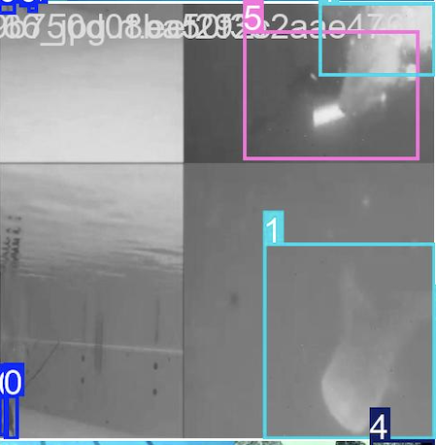
Introduction
Objective: Explain the aim of your project, including what types of objects your model is intended to detect and the motivation behind using YOLO for object detection.
Background: Provide a brief overview of YOLO (You Only Look Once) and its significance in real-time object detection.
Scope: Outline the areas where this model could be applied, such as surveillance, autonomous driving, or image analysis.A

Slide 3
Abstract
Developed a custom object detection model using YOLO, tailored for specific object classes.
Dataset Preparation: Collected, labelled, and augmented data for improved robustness.
Model Training: Tuned hyperparameters to optimize accuracy and real-time detection.
Evaluation: Assessed performance using mAP and IoU metrics.
Key Findings: High detection accuracy across target classes.
Enhanced robustness to varying conditions (e.g., lighting, orientation).
Improved small object detection via optimized anchor boxes.

Slide 4
Abstract (contd.)
Dataset Collection and Pre-processing
Detail how you gathered and annotated your dataset. Mention any specific labelling tools used (e.g., LabelImg).
Describe pre-processing steps such as resizing, augmentation, or data normalization.
YOLO Model Architecture
Provide an overview of the YOLO architecture used (mention specific changes if your version has custom layers or modifications).
Explain anchor boxes, grid cells, and how YOLO predicts bounding boxes and class probabilities.

Slide 5
Abstract (contd.)
Model Training and Fine-Tuning
Discuss the training process, including hyperparameters such as batch size, learning rate, and the number of epochs.
Mention any hardware resources used (e.g., GPU/TPU).
Include any fine-tuning techniques, such as transfer learning or using pretrained weights.

Slide 6
Implementation
Software and Libraries
TensorFlow & Keras: Model development and training.
NumPy & Pandas: Data manipulation and analysis.
OpenCV: Image processing tasks.
Code Overview
Data Loading: Preprocess and normalize data.
Model Definition: Construct and compile networks.
Evaluation: Calculate performance metrics.
Challenges and Solutions
Overfitting: Used dropout layers.
Imbalanced Data: Applied class weighting.
Noisy Data: Implemented preprocessing techniques.

Slide 7
Results
Evaluation Metrics: Define the metrics used, such as mean Average Precision (mAP), Intersection over Union (IoU), and any relevant precision/recall values.
Performance Analysis: Summarize the model’s performance, including accuracy or mAP scores on test data, and discuss any interesting findings.
Sample Predictions: Include images or screenshots showing the model's predictions on sample data, with bounding boxes around detected objects.

Slide 8
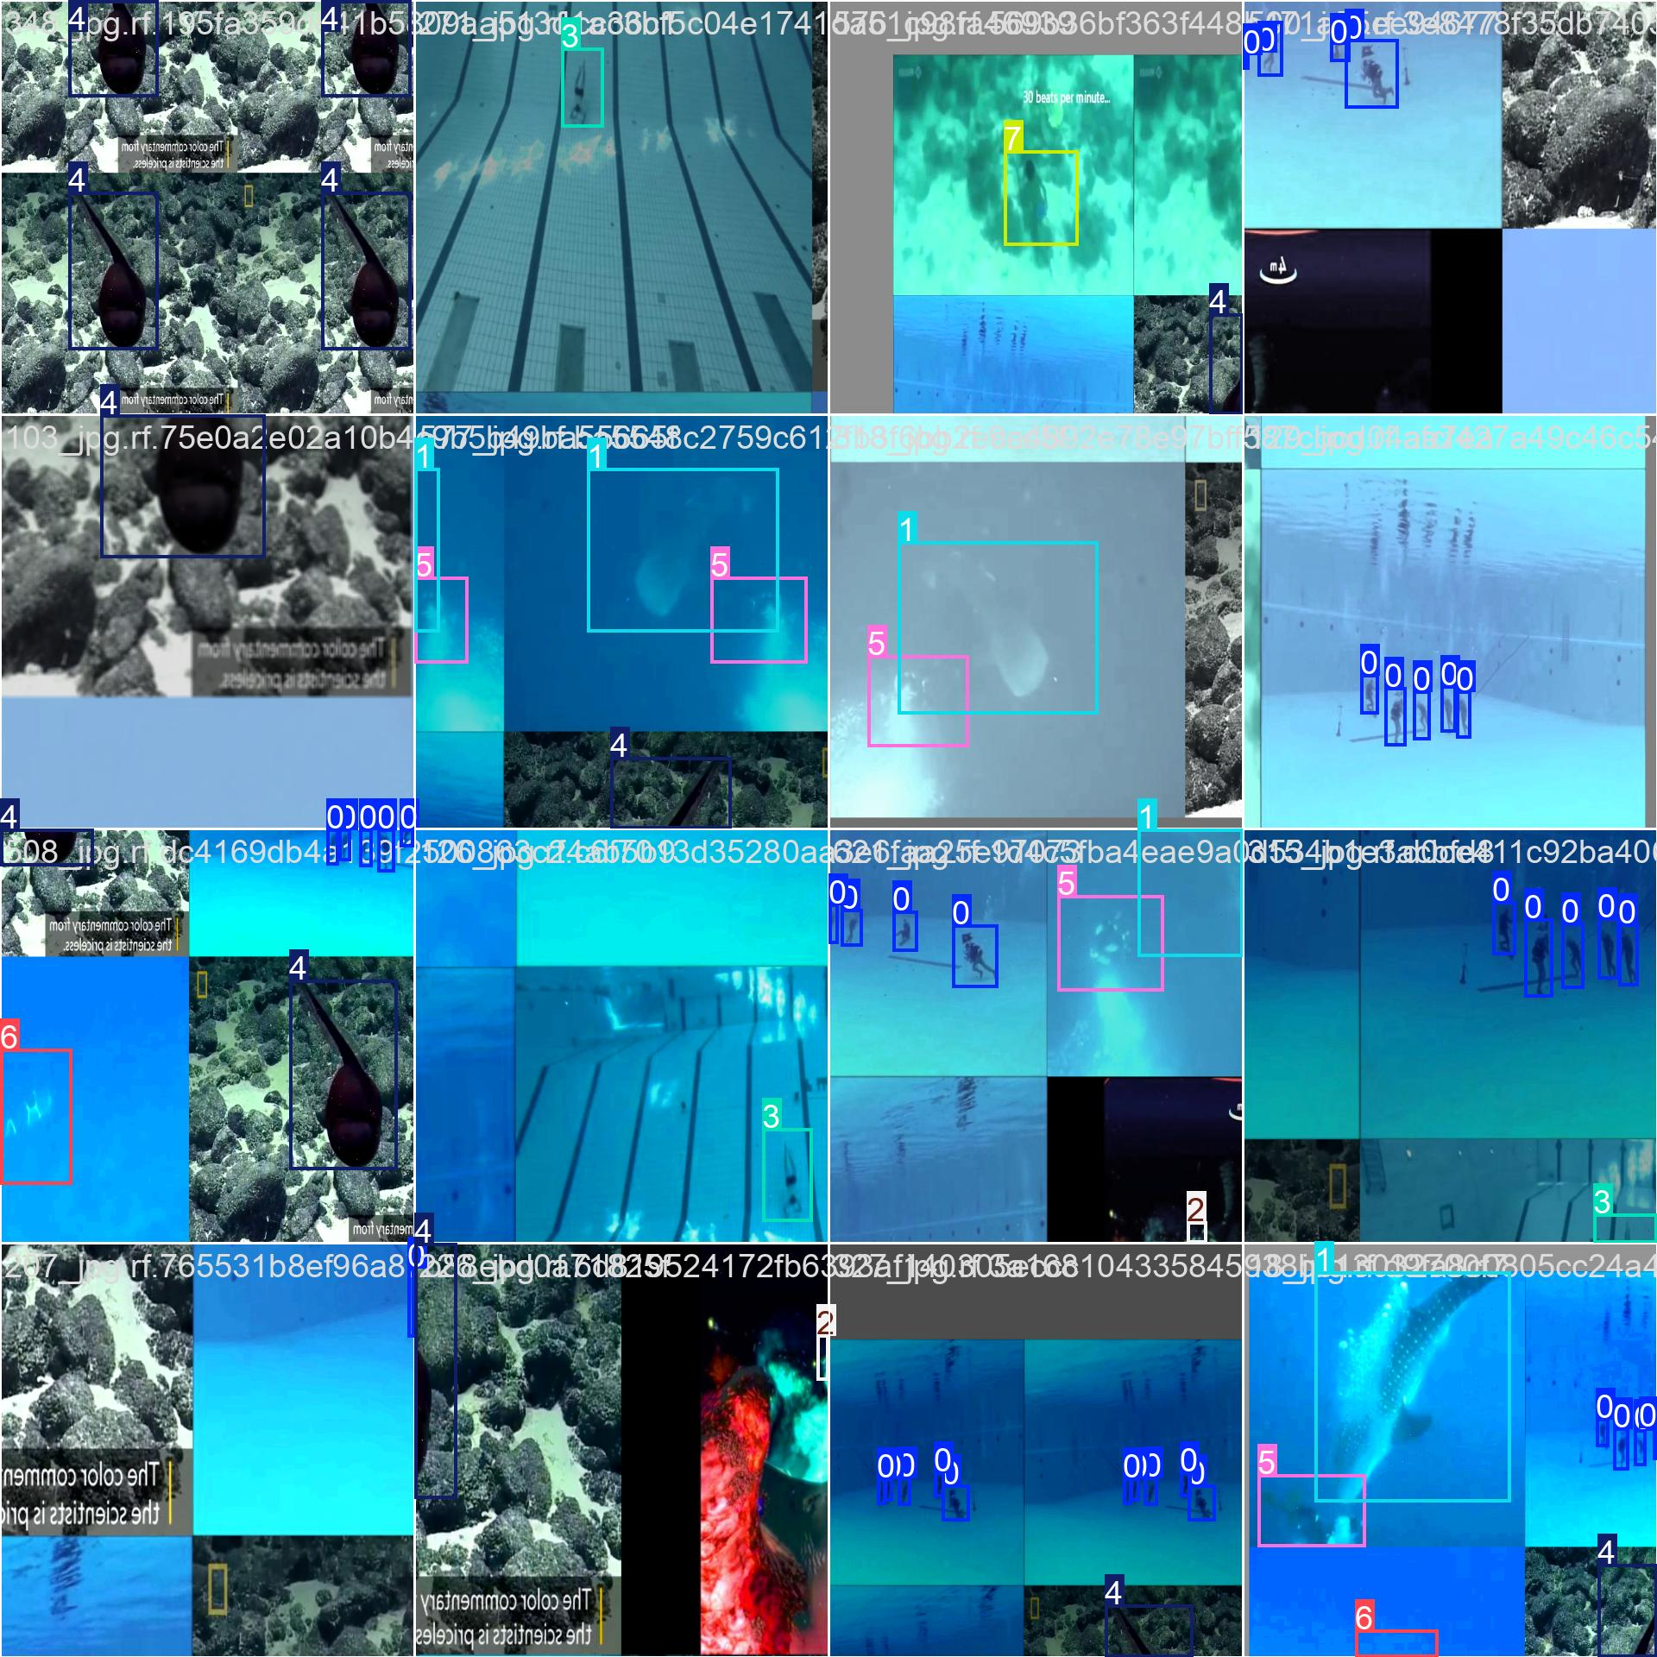
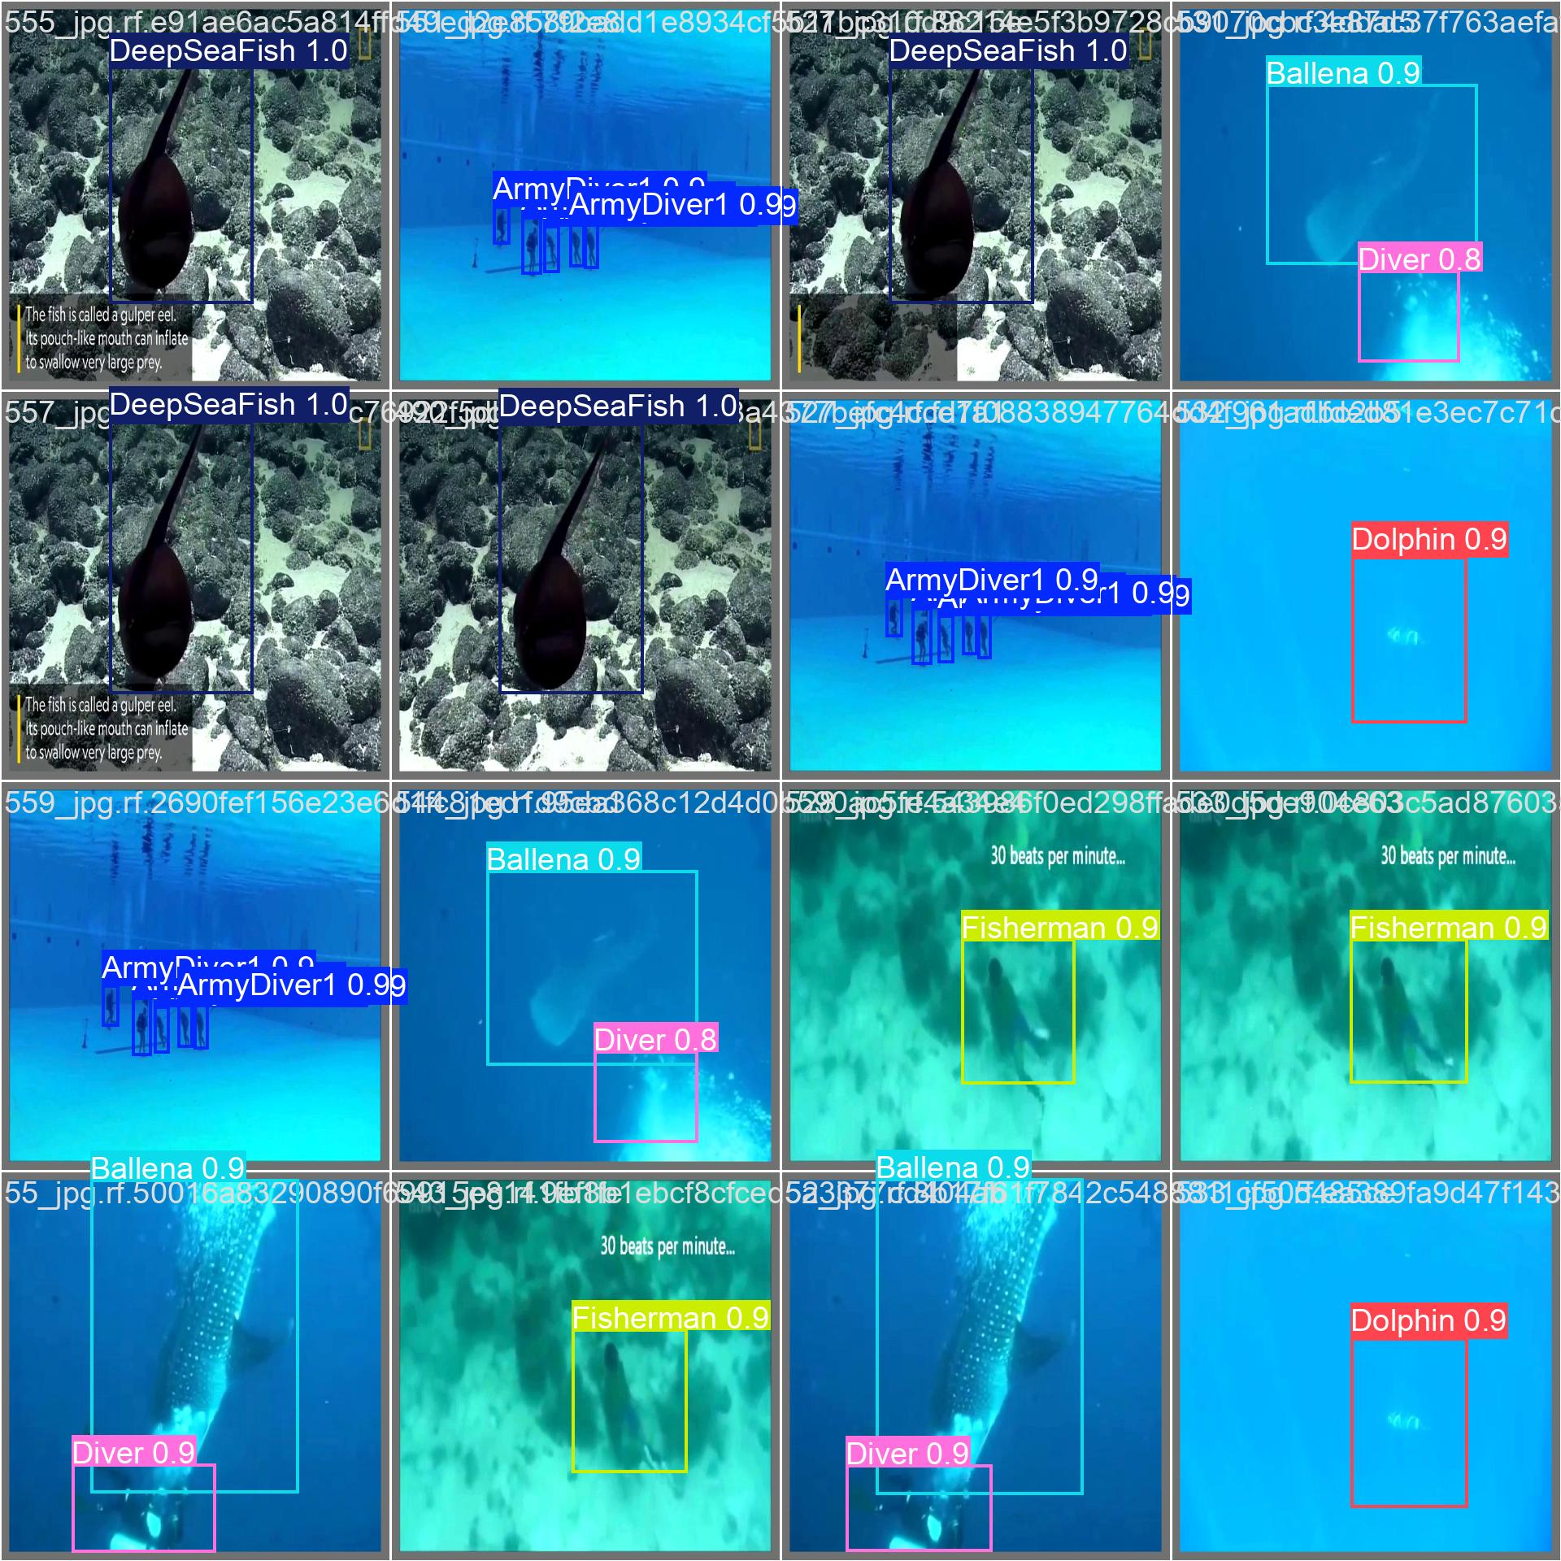
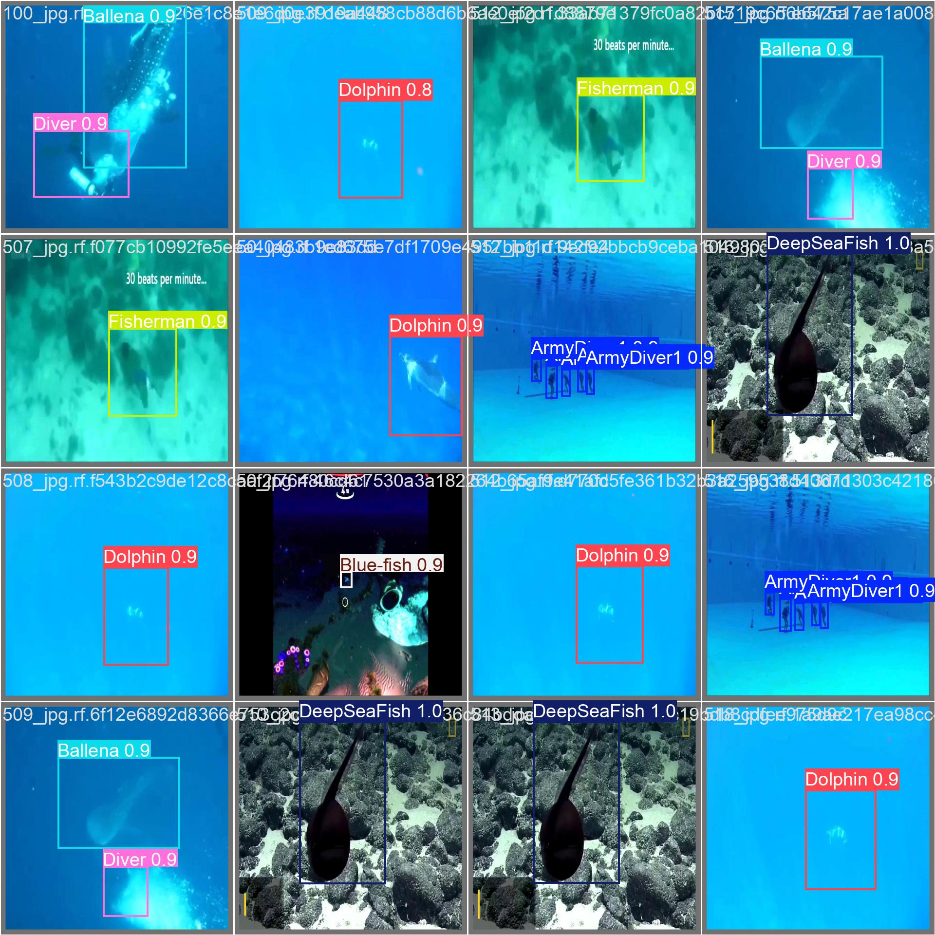
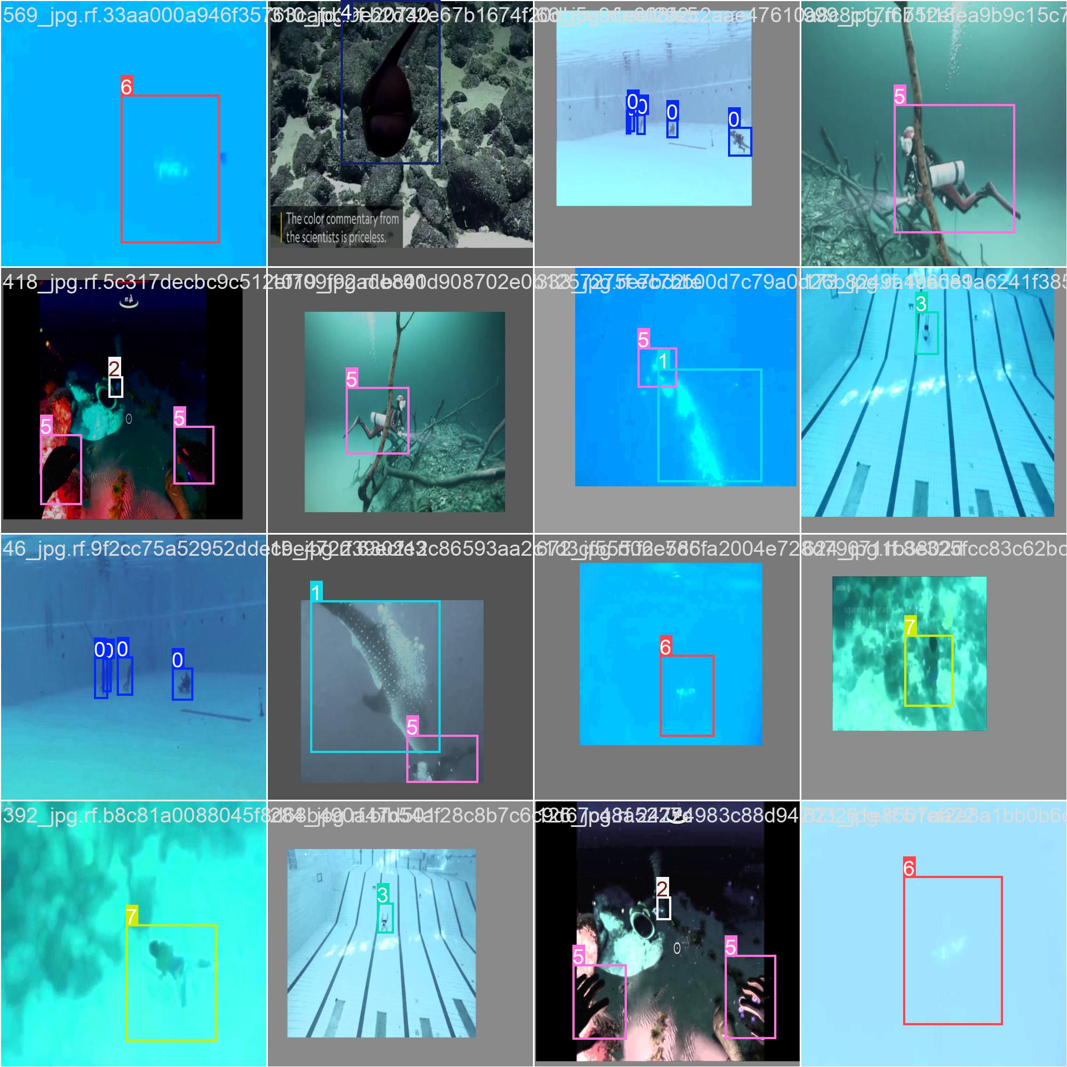

Slide 9
Conclusion
Project Achievements
Developed a high-accuracy object detection model.
Demonstrated real-time processing capabilities.
Enhanced generalization across diverse conditions.
Practical Applications
Security Systems: Identifying unauthorized individuals.
Retail Analytics: Monitoring customer behaviour and preventing theft.
Autonomous Vehicles: Recognizing pedestrians and obstacles.
Contribution to Object Detection
Improved methods for detecting camouflaged targets.
Paved the way for future advancements in detection algorithms.
Provided a foundation for enhancing accuracy and efficiency in various applications.

